Slide 1

PICO CODING
Kent State University

Slide 2
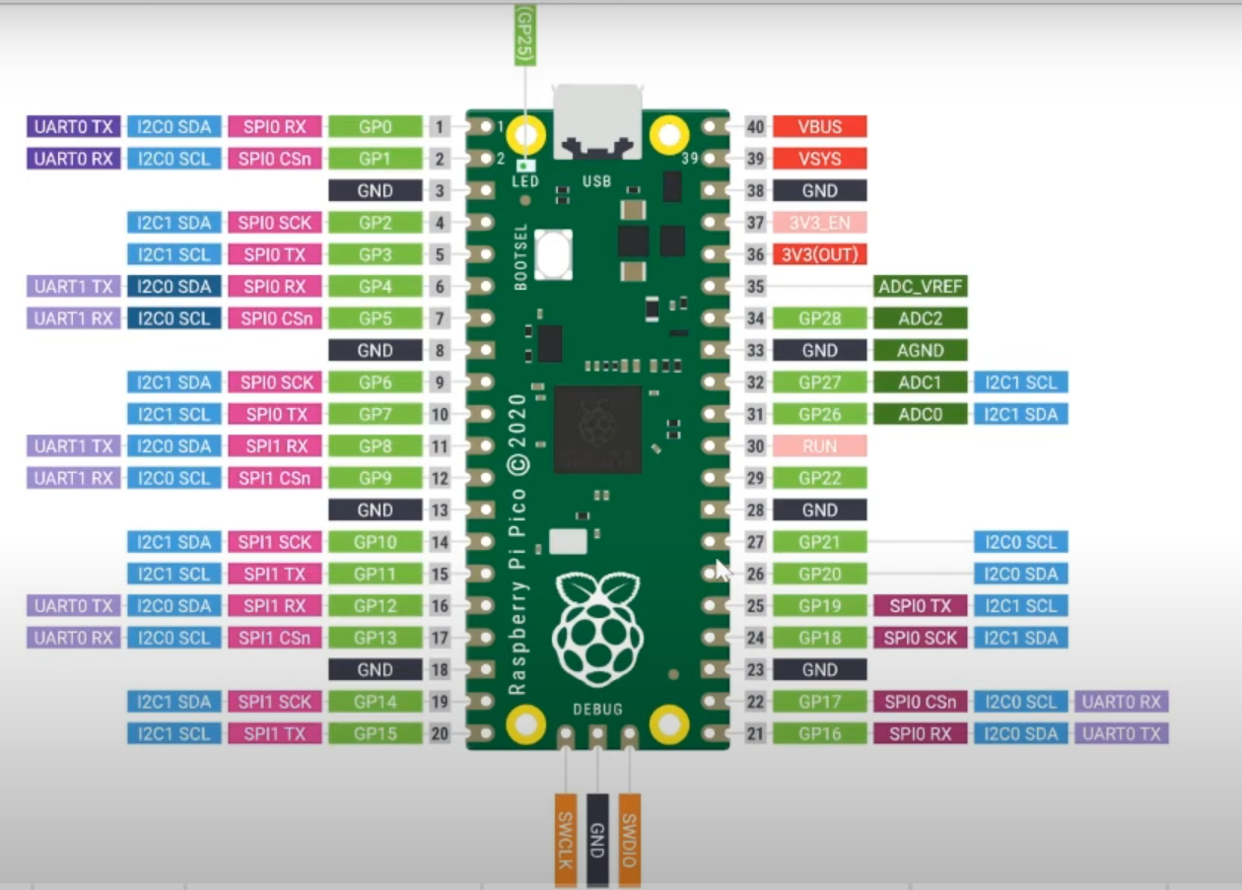
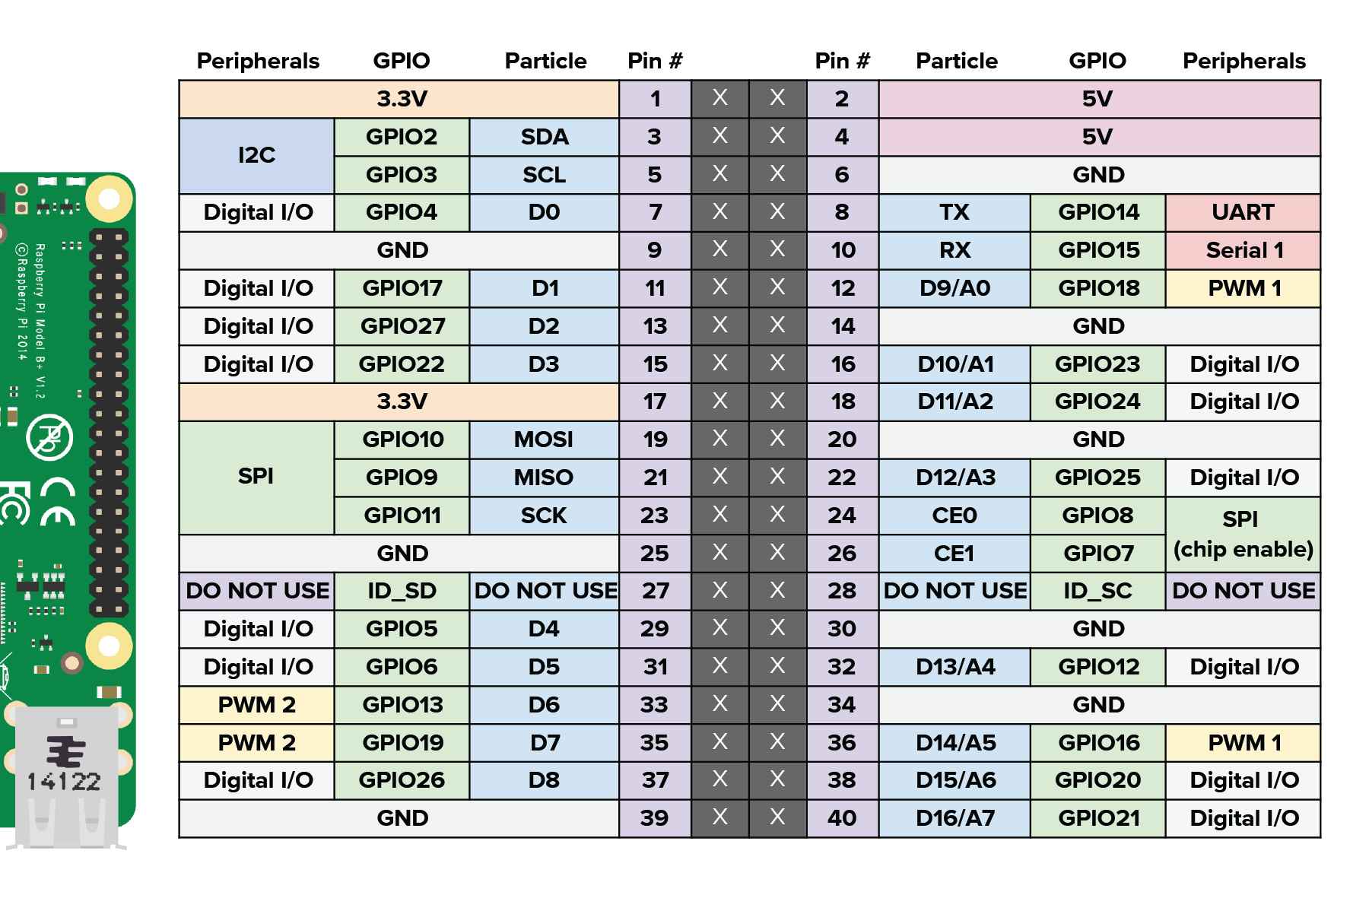
PIN DIAGRAM

Slide 3
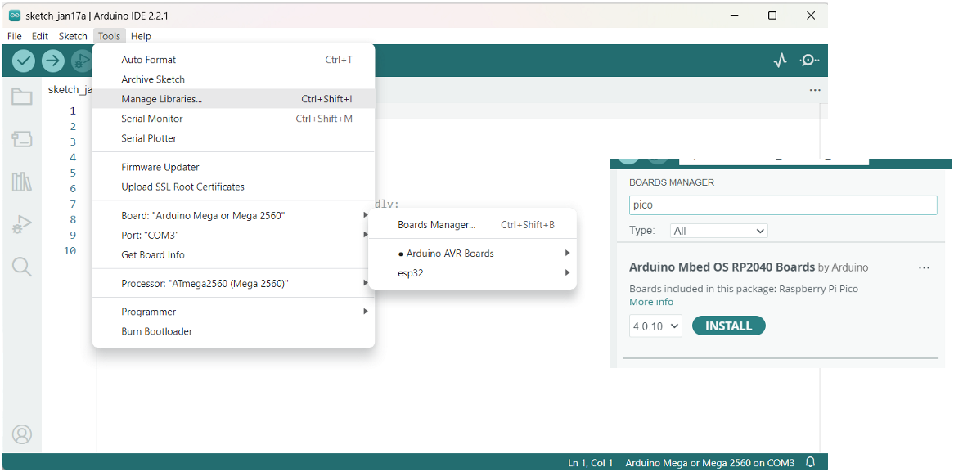
Coding using Arduino IDE

Slide 4
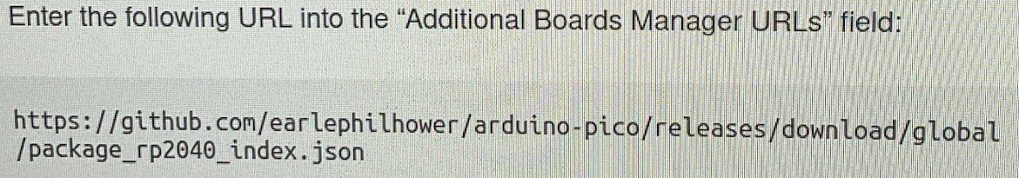
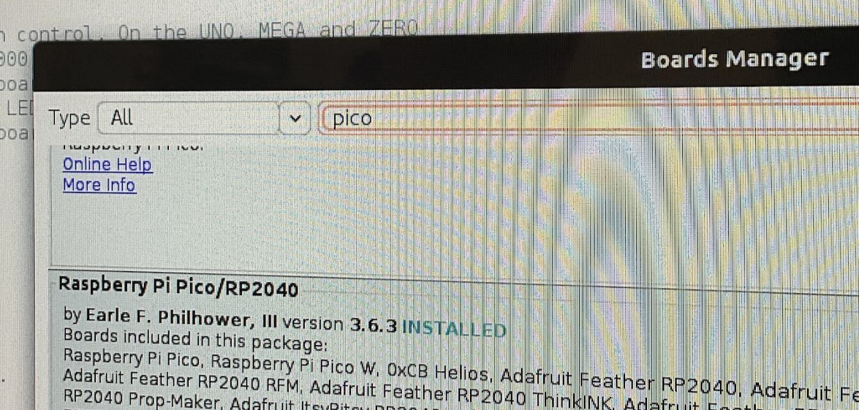
If serial port issues: FILE -> Preference and select Additional board manager URLs: paste the URL Install new Board: Board manager -> PICO -> Raspberry Pi Pico/RP2040

Slide 5
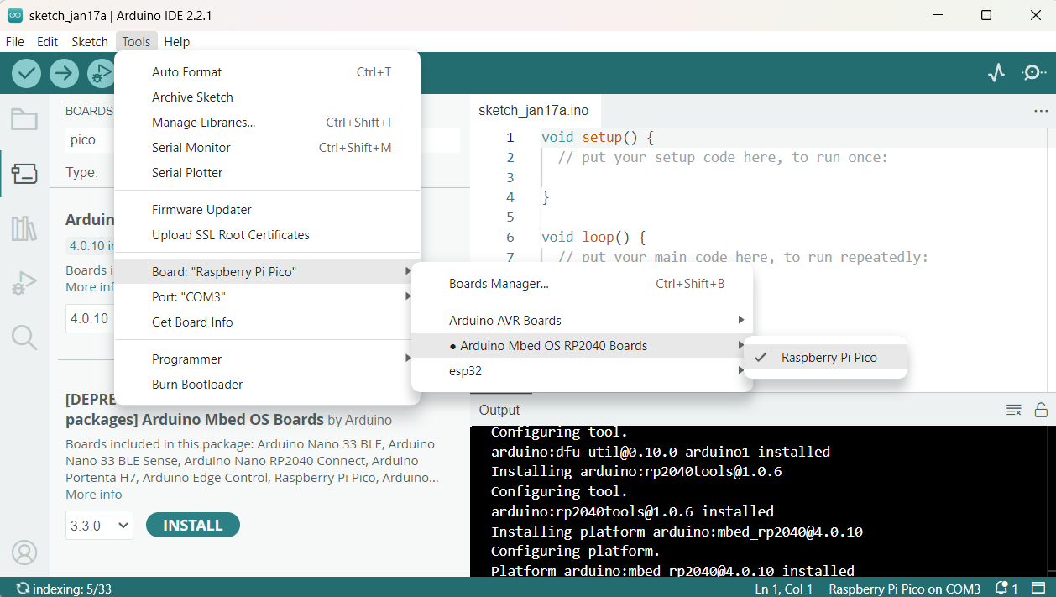
Programming

Slide 6
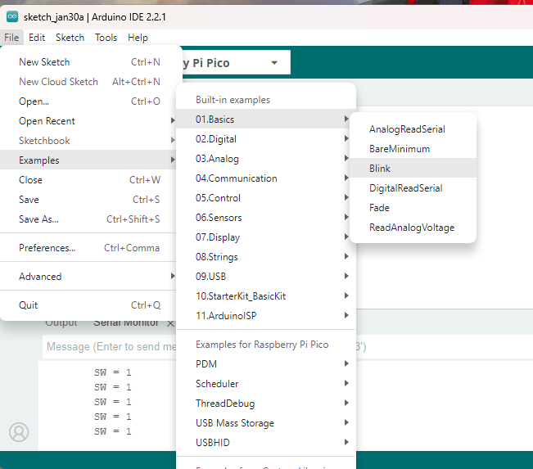
Programme Example: Blink
void setup() {
// initialize digital pin LED_BUILTIN as an output.
pinMode(2, OUTPUT);
}
// the loop function runs over and over again forever
void loop() {
digitalWrite(2, HIGH); // turn the LED on (HIGH is the voltage level)
delay(1000); // wait for a second
digitalWrite(2, LOW); // turn the LED off by making the voltage LOW
delay(1000); // wait for a second
}

Slide 7
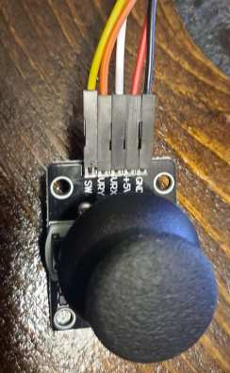
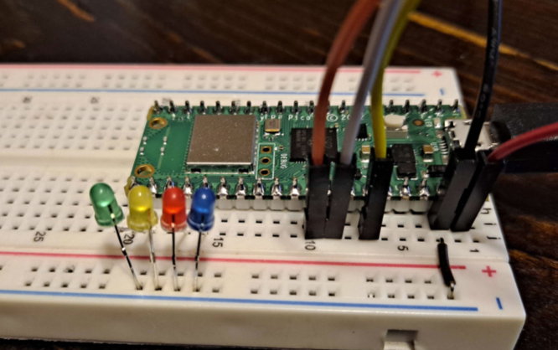
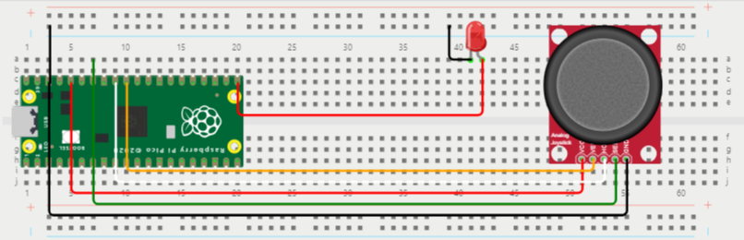
Programming 1:Digital Input - Joystick
const int SWPin = 28;
const int ledPin1 = 16;
int SW = 0; // value read from the switch
void setup() {
Serial.begin(9600);
pinMode(SWPin, INPUT_PULLUP); // Using INPUT_PULLUP to enable internal pull-up resistor
pinMode(ledPin1, OUTPUT);
}
void loop() {
SW = digitalRead(SWPin);
// If the switch is pressed (LOW state), turn on the LED; otherwise, turn it off
if (SW == LOW) {
digitalWrite(ledPin1, HIGH); // Turn on the LED
} else {
digitalWrite(ledPin1, LOW); // Turn off the LED
}
// Print the switch state to the Serial Monitor
Serial.print("\tSW = ");
Serial.println(SW);
delay(200);
}
For online Simulations: https://wokwi.com/projects/388409192132115457

Slide 8
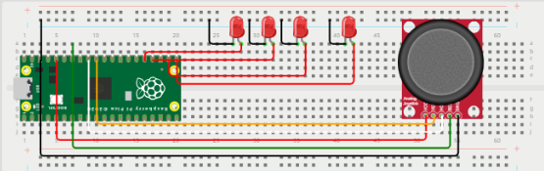
Programming 2:Digital Input - Joystick
const int SWPin = 28;
const int ledPin1 = 16;
const int ledPin2 = 17;
const int ledPin3 = 18;
const int ledPin4 = 19;
int SW = 0; // value read from the switch
int count = 0; // LED state counter
void setup() {
Serial.begin(9600);
pinMode(SWPin, INPUT_PULLUP); // Using INPUT_PULLUP to enable internal pull-up resistor
pinMode(ledPin1, OUTPUT);
pinMode(ledPin2, OUTPUT);
pinMode(ledPin3, OUTPUT);
pinMode(ledPin4, OUTPUT);
}
void loop() {
SW = digitalRead(SWPin);
// If the switch is pressed (LOW state), increment the count
if (SW == LOW) {
count++;
delay(200); // Debounce delay
}
// Set the LED states based on the count
if (count == 1) {
digitalWrite(ledPin1, HIGH); digitalWrite(ledPin2, LOW); digitalWrite(ledPin3, LOW); digitalWrite(ledPin4, LOW);
} else if (count == 2) {
digitalWrite(ledPin1, LOW); digitalWrite(ledPin2, HIGH); digitalWrite(ledPin3, LOW); digitalWrite(ledPin4, LOW);
} else if (count == 3) {
digitalWrite(ledPin1, LOW); digitalWrite(ledPin2, LOW); digitalWrite(ledPin3, HIGH); digitalWrite(ledPin4, LOW);
} else if (count == 4) {
digitalWrite(ledPin1, LOW); digitalWrite(ledPin2, LOW); digitalWrite(ledPin3, LOW); digitalWrite(ledPin4, HIGH);
} else if (count == 5) {
// Reset count to 0 and turn off all LEDs
count = 0;
digitalWrite(ledPin1, LOW); digitalWrite(ledPin2, LOW); digitalWrite(ledPin3, LOW); digitalWrite(ledPin4, LOW);
}
// Print the switch state and count to the Serial Monitor
Serial.print("\tSW = ");
Serial.print(SW);
Serial.print("\tCount = ");
Serial.println(count);
delay(200);
}
For online Simulations: https://wokwi.com/projects/388405873357123585

Slide 9
Programming 2:Digital Input – Joystick (FLAG)
A button (connected to the SWPin) controls four LEDs (connected to ledPin1, ledPin2, ledPin3, and ledPin4). The button press cycles through the LEDs, lighting them up one at a time in sequence. The count variable keeps track of the button presses, determining which LED to light up. The cycle goes from LED 1 to LED 4, and then resets, turning all LEDs off and starting over. The lastButtonState variable acts as a flag to store the last state of the button, allowing the code to detect state changes from HIGH to LOW (button press). This implementation does not include a debounce mechanism to handle button bounce, except for an optional delay commented out that could be used for debouncing. The state of the switch, the flag (indicating the last button state), and the count are printed to the Serial Monitor for debugging purposes.
const int SWPin = 28; // Pin connected to the switch
const int ledPin1 = 16; // Pin connected to LED 1
const int ledPin2 = 17; // Pin connected to LED 2
const int ledPin3 = 18; // Pin connected to LED 3
const int ledPin4 = 19; // Pin connected to LED 4
int lastButtonState; // Acting as Flag that Stores the last state of the button.
int currentButtonState; // Stores the current state of the button
int count = 0; // Counter for cycling through LED states void setup() {
Serial.begin(9600); // Start serial communication at 9600 bps
pinMode(SWPin, INPUT_PULLUP); // Set the switch pin as input with internal pull-up
pinMode(ledPin1, OUTPUT); // Set LED 1 pin as output
pinMode(ledPin2, OUTPUT); // Set LED 2 pin as output
pinMode(ledPin3, OUTPUT); // Set LED 3 pin as output
pinMode(ledPin4, OUTPUT); // Set LED 4 pin as output // Read the initial state of the button and set it as the last button state
lastButtonState = digitalRead(SWPin);
}
void loop() {
currentButtonState = digitalRead(SWPin); // Read the current state of the switch // Check for button press (transition from HIGH to LOW)
if (currentButtonState == LOW && lastButtonState == HIGH) {
// Increment the count only if the button was released before
count++;
// Optional: Add delay here for debouncing if needed
} // Save the current state as the last state, for next time through the loop
lastButtonState = currentButtonState; // Flag is to Update the lastButtonState for the next iteration // Set the LED states based on the count
switch (count) {
case 1:
digitalWrite(ledPin1, HIGH); digitalWrite(ledPin2, LOW); digitalWrite(ledPin3, LOW); digitalWrite(ledPin4, LOW);
break;
case 2:
digitalWrite(ledPin1, LOW); digitalWrite(ledPin2, HIGH); digitalWrite(ledPin3, LOW); digitalWrite(ledPin4, LOW);
break;
case 3:
digitalWrite(ledPin1, LOW); digitalWrite(ledPin2, LOW); digitalWrite(ledPin3, HIGH);digitalWrite(ledPin4, LOW);
break;
case 4:
digitalWrite(ledPin1, LOW); digitalWrite(ledPin2, LOW); digitalWrite(ledPin3, LOW); digitalWrite(ledPin4, HIGH);
break;
case 5:
// Reset count to 0 and turn off all LEDs
count = 0;
digitalWrite(ledPin1, LOW);digitalWrite(ledPin2, LOW);digitalWrite(ledPin3, LOW);digitalWrite(ledPin4, LOW);break;
}
// Print the switch state (current button state), Flag state (last button state) and count to the Serial Monitor for debugging
// Serial monitor is the Magnetic Symbol, Located on the Top most right of the screen
Serial.print("\tSW = "); Serial.print(currentButtonState); Serial.print("\tFlag = "); Serial.print(lastButtonState); Serial.print("\tCount = "); Serial.println(count);}
For online Simulations: https://wokwi.com/projects/389037186644677633

Slide 10
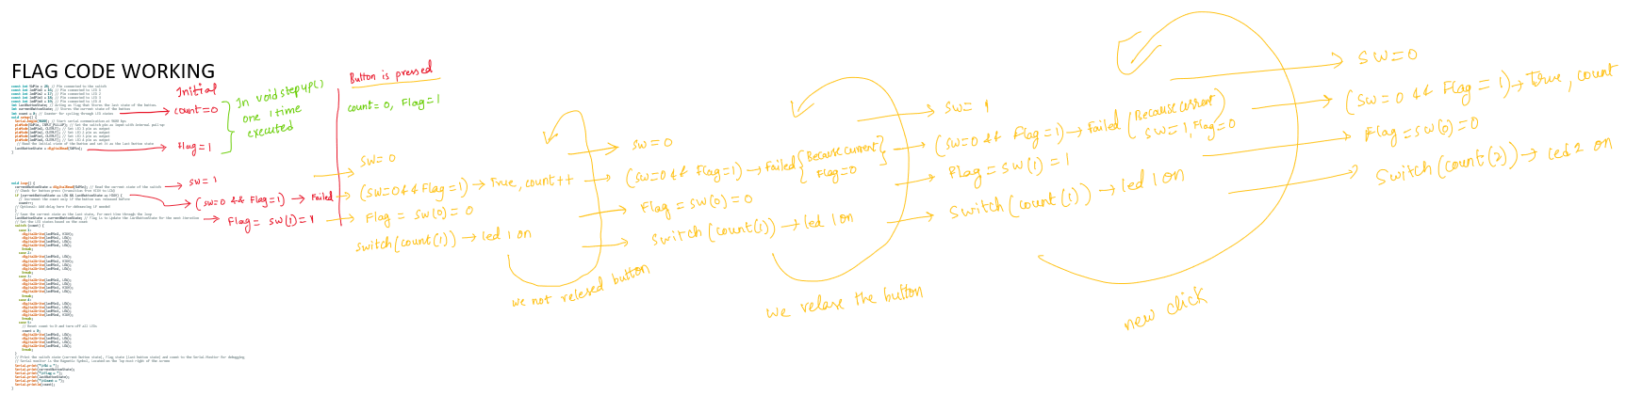
FLAG WORKING
The code detects button presses by checking for a HIGH to LOW transition, increments a counter to cycle through LEDs, turning one on at a time while turning others off. Upon reaching a count of 5, it resets, starting the cycle anew. It also outputs the button states and count to the Serial Monitor for debugging.
For Online Simulator – Solution for Bouncing -> add Bouncing delay(100) or Use code Bouncing
Bouncing, in the context of electronic switches and buttons, refers to the rapid, unintended fluctuation in the electrical state that occurs when a switch is moved from an open to a closed position (or vice versa). When you press or release a button, instead of the electrical contact being made or broken cleanly with a single, smooth transition from HIGH to LOW (or LOW to HIGH), the physical contacts within the switch will momentarily make and break contact several times before settling into their final state. This effect happens in a very short time frame, typically milliseconds.

Slide 11
Programming 2:Digital Input – Joystick (Bouncing TIME)
All four LEDs (LED 1, LED 2, LED 3, and LED 4) are controlled by a switch, with each button press cycling through the LEDs sequentially. Upon pressing the switch, the code increases a counter that determines which LED is turned on—each LED corresponds to a specific count value (1 through 4). Once the count surpasses 4, it resets to 0, allowing the cycle to start over. The switch's state is debounced to prevent false triggering from electrical noise, using a fixed debounce delay. This implementation does not include a separate timer function for any of the LEDs; instead, all LEDs are directly controlled by the switch press count.
void loop() {
// Read the current state of the switch
int reading = digitalRead(SWPin);
// Check if the button state has changed to start the debounce timer
if (reading != lastButtonState) {
lastDebounceTime = millis();
}
// Check if the debounce period has passed
if ((millis() - lastDebounceTime) > debounceDelay) {
// If the button state has changed after the debounce period, update the current state
if (reading != currentButtonState) {
currentButtonState = reading;
// Change the count and LED states only if the new state is LOW (button pressed)
if (currentButtonState == LOW) {
count++;
if (count > 4) {
count = 0; // Reset the count after the fourth LED
}}}} // Update LEDs based on the current count
digitalWrite(ledPin1, count == 1 ? HIGH : LOW);
digitalWrite(ledPin2, count == 2 ? HIGH : LOW);
digitalWrite(ledPin3, count == 3 ? HIGH : LOW);
digitalWrite(ledPin4, count == 4 ? HIGH : LOW);
// Update lastButtonState to the latest reading for the next loop iteration
lastButtonState = reading;
// Debugging output to Serial Monitor
Serial.print("\tSW = ");
Serial.print(currentButtonState);
Serial.print("\tFlag = ");
Serial.print(lastButtonState);
Serial.print("\tCount = ");
Serial.println(count);
}
const int SWPin = 28; // Pin connected to the switch
const int ledPin1 = 16; // Pin connected to LED 1
const int ledPin2 = 17; // Pin connected to LED 2
const int ledPin3 = 18; // Pin connected to LED 3
const int ledPin4 = 19; // Pin connected to LED 4
int lastButtonState; int currentButtonState; // Stores the current state of the button
int count = 0; // Counter for cycling through LED states
unsigned long lastDebounceTime = 0; // Tracks the last debounce time
unsigned long debounceDelay = 50; // Debounce delay in milliseconds
void setup() {
Serial.begin(9600);
pinMode(SWPin, INPUT_PULLUP);
pinMode(ledPin1, OUTPUT);
pinMode(ledPin2, OUTPUT);
pinMode(ledPin3, OUTPUT);
pinMode(ledPin4, OUTPUT);
// Initialize lastButtonState with the current state of the switch
lastButtonState = digitalRead(SWPin);
}
For online Simulations: https://wokwi.com/projects/389040007226423297

Slide 12
Programming 2:Digital Input – Joystick (Bouncing TIME) + Flashing
The three LEDs (LED 1, LED 2, LED 3) will be controlled by the switch, cycling through them with each button press. The fourth LED (LED 4) will serve as a timer indication, blinking at a regular interval independently of the switch presses.
void loop() {
// Read the current state of the switch
int reading = digitalRead(SWPin);
// Check if the button state has changed to start the debounce timer
if (reading != lastButtonState) {
lastDebounceTime = millis();
}
// Check if the debounce period has passed
if ((millis() - lastDebounceTime) > debounceDelay) {
// If the button state has changed after the debounce period, update the current state
if (reading != currentButtonState) {
currentButtonState = reading;
// Change the count and LED states only if the new state is LOW (button pressed)
if (currentButtonState == LOW) {
count++;
if (count > 3) { // Now resetting after the third LED
count = 0; // Reset the count after the third LED
}
}
}
}
// Update LEDs based on the current count
digitalWrite(ledPin1, count == 1 ? HIGH : LOW);
digitalWrite(ledPin2, count == 2 ? HIGH : LOW);
digitalWrite(ledPin3, count == 3 ? HIGH : LOW);
// Blink timer LED at a regular interval
if ((millis() - lastBlinkTime) > blinkInterval) {
// Toggle the timer LED state
digitalWrite(timerLedPin, !digitalRead(timerLedPin));
// Update the last blink time
lastBlinkTime = millis();
} // Update lastButtonState to the latest reading for the next loop iteration
lastButtonState = reading; // Debugging output to Serial Monitor
Serial.print("\tSW = ");
Serial.print(currentButtonState);
Serial.print("\tFlag = ");
Serial.print(lastButtonState);
Serial.print("\tCount = ");
Serial.println(count);
}
const int SWPin = 28; // Pin connected to the switch
const int ledPin1 = 16; // Pin connected to LED 1
const int ledPin2 = 17; // Pin connected to LED 2
const int ledPin3 = 18; // Pin connected to LED 3
const int timerLedPin = 19; // Pin connected to the Timer LED
int lastButtonState; // Assume switch is not pressed initially
int currentButtonState; // Stores the current state of the button
int count = 0; // Counter for cycling through LED states
unsigned long lastDebounceTime = 0; // Tracks the last debounce time
unsigned long debounceDelay = 50; // Debounce delay in milliseconds
unsigned long lastBlinkTime = 0; // Tracks the last time the timer LED blinked
unsigned long blinkInterval = 1000; // Interval at which the timer LED blinks (1 second)
void setup() {
Serial.begin(9600);
pinMode(SWPin, INPUT_PULLUP);
pinMode(ledPin1, OUTPUT);
pinMode(ledPin2, OUTPUT);
pinMode(ledPin3, OUTPUT);
pinMode(timerLedPin, OUTPUT);
// Initialize lastButtonState with the current state of the switch
lastButtonState = digitalRead(SWPin);
}
For online Simulations: https://wokwi.com/projects/389048579674120193

Slide 13
Programming 3:Analog Input - Joystick
const int SWPin = 28;
const int ledPin1 = 16;
const int ledPin2 = 17;
const int ledPin3 = 18;
const int ledPin4 = 19;
const int VRxPin = 27; // Joystick VRx connected to pin 27
const int VRyPin = 26; // Joystick VRy connected to pin 26
int SW = 0; // value read from the switch
void setup() {
Serial.begin(9600);
pinMode(SWPin, INPUT_PULLUP); // Using INPUT_PULLUP to enable internal pull-up resistor
pinMode(VRxPin, INPUT_PULLUP);
pinMode(VRyPin, INPUT_PULLUP);
pinMode(ledPin1, OUTPUT);
pinMode(ledPin2, OUTPUT);
pinMode(ledPin3, OUTPUT);
pinMode(ledPin4, OUTPUT);
}
void loop() {
SW = digitalRead(SWPin);
// Read the analog values of joystick VRx and VRy
int VRxValue = analogRead(VRxPin);
int VRyValue = analogRead(VRyPin);
// Map the joystick values to LED states and brightness
int ledState = map(VRxValue, 0, 1023, 1, 5); // Map VRx to LED states (1-5)
int brightness = map(VRyValue, 0, 1023, 0, 255); // Map VRy to brightness (0-255)
// Set the LED states based on the mapped values using if statements
if (ledState == 1) {
digitalWrite(ledPin1, HIGH);
digitalWrite(ledPin2, LOW);
digitalWrite(ledPin3, LOW);
digitalWrite(ledPin4, LOW);
} else if (ledState == 2) {
digitalWrite(ledPin1, LOW);
digitalWrite(ledPin2, HIGH);
digitalWrite(ledPin3, LOW);
digitalWrite(ledPin4, LOW);
} else if (ledState == 4) {
digitalWrite(ledPin1, LOW);
digitalWrite(ledPin2, LOW);
digitalWrite(ledPin3, HIGH);
digitalWrite(ledPin4, LOW);
} else if (ledState == 5) {
digitalWrite(ledPin1, LOW);
digitalWrite(ledPin2, LOW);
digitalWrite(ledPin3, LOW);
digitalWrite(ledPin4, HIGH);
} else {
// Turn off all LEDs if ledState is not in the expected range
digitalWrite(ledPin1, LOW);
digitalWrite(ledPin2, LOW);
digitalWrite(ledPin3, LOW);
digitalWrite(ledPin4, LOW);
}
// Print the switch state, LED state, and brightness to the Serial Monitor
Serial.print("\tSW = ");
Serial.print(SW);
Serial.print("\tLED State = ");
Serial.print(ledState);
delay(200);
}
The code configures pins for a joystick, switch, and LEDs.
It reads joystick values, maps them to control LED states and prints the switch state, LED state to the Serial Monitor.
For online Simulations: https://wokwi.com/projects/388410322257095681

Slide 14
Programming 4:Analog Input - Joystick
const int SWPin = 28;
const int ledPin1 = 16;
const int ledPin2 = 17;
const int ledPin3 = 18;
const int ledPin4 = 19;
const int VRxPin = 27; // Joystick VRx connected to pin 27
const int VRyPin = 26; // Joystick VRy connected to pin 26
int SW = 0; // value read from the switch
void setup() {
Serial.begin(9600);
pinMode(SWPin, INPUT_PULLUP); // Using INPUT_PULLUP to enable internal pull-up resistor
pinMode(VRxPin, INPUT_PULLUP);
pinMode(VRyPin, INPUT_PULLUP);
pinMode(ledPin1, OUTPUT);
pinMode(ledPin2, OUTPUT);
pinMode(ledPin3, OUTPUT);
pinMode(ledPin4, OUTPUT);
}
void loop() {
SW = digitalRead(SWPin);
// Read the analog values of joystick VRx and VRy
int VRxValue = analogRead(VRxPin);
int VRyValue = analogRead(VRyPin);
// Map the joystick values to LED states and brightness
int ledState = map(VRxValue, 0, 1023, 1, 5); // Map VRx to LED states (1-5)
int brightness = map(VRyValue, 0, 1023, 0, 255); // Map VRy to brightness (0-255)
// Set the brightness for all LEDs
analogWrite(ledPin1, brightness);
analogWrite(ledPin2, brightness);
analogWrite(ledPin3, brightness);
analogWrite(ledPin4, brightness);
// Print the switch state, LED state, and brightness to the Serial Monitor
Serial.print("\tSW = ");
Serial.print(SW);
Serial.print("\tBrightness = ");
Serial.println(brightness);
delay(200);
}
The code reads a joystick and switch, maps joystick values to control LED brightness, and prints switch state and brightness to the Serial Monitor while setting all LEDs to the same brightness
For online Simulations: https://wokwi.com/projects/388412892116938753

Slide 15
Programming 5:Analog Input - Joystick
const int SWPin = 28;
const int ledPin1 = 16;
const int ledPin2 = 17;
const int ledPin3 = 18;
const int ledPin4 = 19;
const int VRxPin = 27; // Joystick VRx connected to pin 27
const int VRyPin = 26; // Joystick VRy connected to pin 26
int SW = 0; // value read from the switch
void setup() {
Serial.begin(9600);
pinMode(SWPin, INPUT_PULLUP); // Using INPUT_PULLUP to enable internal pull-up resistor
pinMode(ledPin1, OUTPUT);
pinMode(ledPin2, OUTPUT);
pinMode(ledPin3, OUTPUT);
pinMode(ledPin4, OUTPUT);
}
void loop() {
SW = digitalRead(SWPin);
// Read the analog values of joystick VRx and VRy
int VRxValue = analogRead(VRxPin);
int VRyValue = analogRead(VRyPin);
// Map the joystick values to LED states and brightness
int ledState = map(VRxValue, 0, 1023, 1, 5); // Map VRx to LED states (1-5)
int brightness = map(VRyValue, 0, 1023, 0, 255); // Map VRy to brightness (0-255)
// Set the LED states based on the mapped values using if statements
if (ledState == 1) {
digitalWrite(ledPin1, HIGH);
digitalWrite(ledPin2, LOW);
digitalWrite(ledPin3, LOW);
digitalWrite(ledPin4, LOW);
analogWrite(ledPin1, brightness);
} else if (ledState == 2) {
digitalWrite(ledPin1, LOW);
digitalWrite(ledPin2, HIGH);
digitalWrite(ledPin3, LOW);
digitalWrite(ledPin4, LOW);
analogWrite(ledPin2, brightness);
} else if (ledState == 4) {
digitalWrite(ledPin1, LOW);
digitalWrite(ledPin2, LOW);
digitalWrite(ledPin3, HIGH);
digitalWrite(ledPin4, LOW);
analogWrite(ledPin3, brightness);
} else if (ledState == 5) {
digitalWrite(ledPin1, LOW);
digitalWrite(ledPin2, LOW);
digitalWrite(ledPin3, LOW);
digitalWrite(ledPin4, HIGH);
analogWrite(ledPin4, brightness);
} else {
// Turn off all LEDs if ledState is not in the expected range
digitalWrite(ledPin1, LOW);
digitalWrite(ledPin2, LOW);
digitalWrite(ledPin3, LOW);
digitalWrite(ledPin4, LOW);
}
// Set the brightness for all LEDs
// Print the switch state, LED state, and brightness to the Serial Monitor
Serial.print("\tSW = ");
Serial.print(SW);
Serial.print("\tLED State = ");
Serial.print(ledState);
Serial.print("\tBrightness = ");
Serial.println(brightness);
delay(200);
}
The code reads a joystick and switch, maps joystick values to control LED brightness and LEDS states, and prints switch state and brightness to the Serial Monitor while setting all LEDs to the same brightness and States
For online Simulations: https://wokwi.com/projects/388412892116938753

Slide 16
Rotary Encoder Module

Slide 17
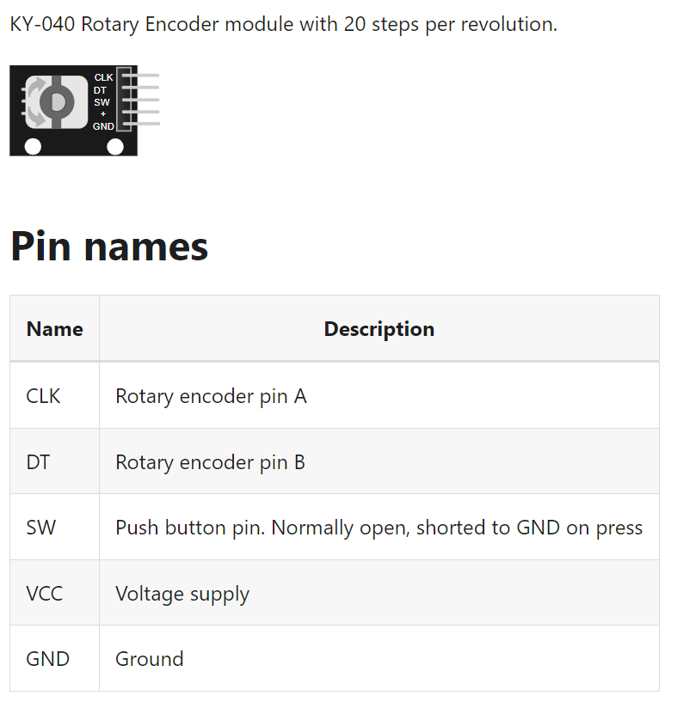
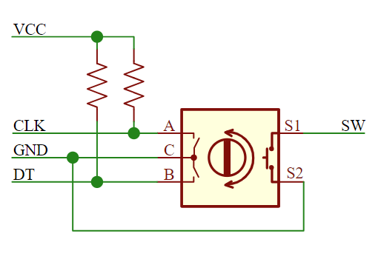
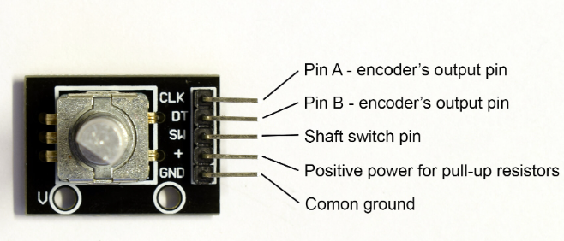
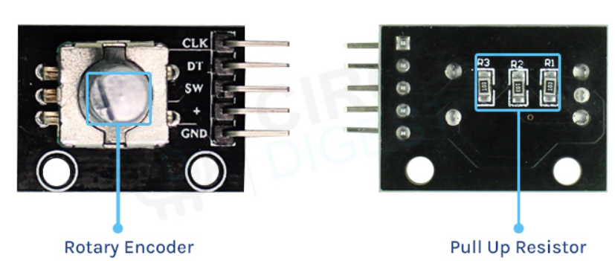
Rotary Encoder Module Pinout
Rotary Encoders are sensors that detect position and speed by converting rotational mechanical displacements into electrical signals and processing those signals. Sensors that detect mechanical displacement for straight lines are referred to as Linear Encoders.

Slide 18
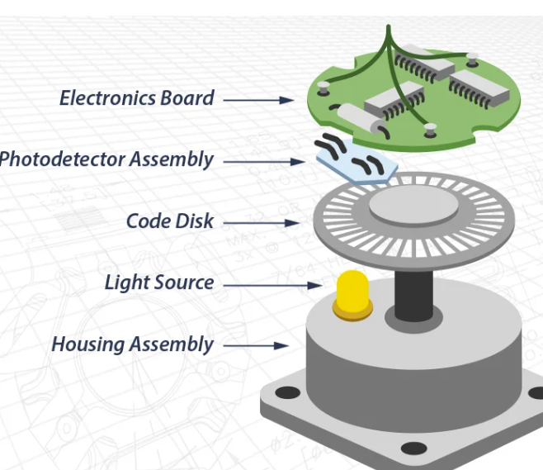
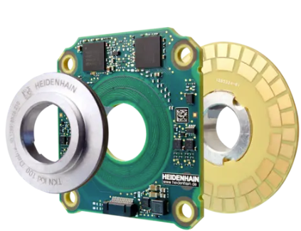
Internal rotary encoders

Slide 19
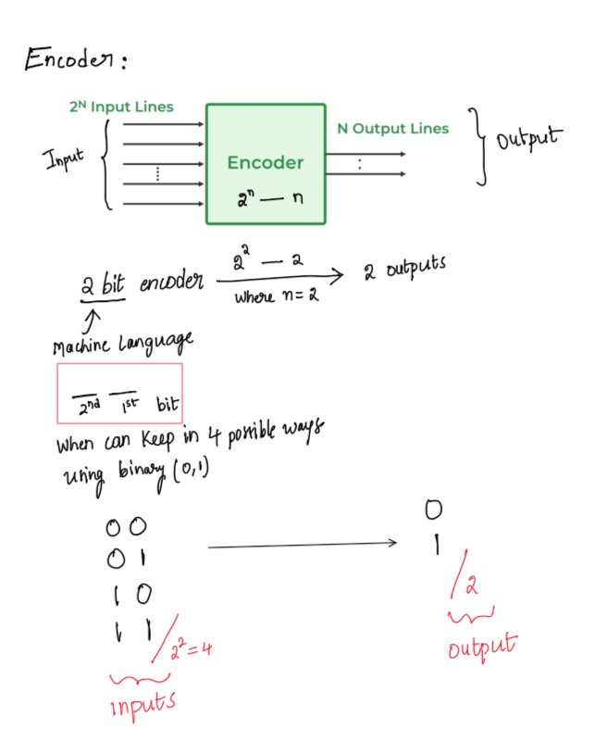
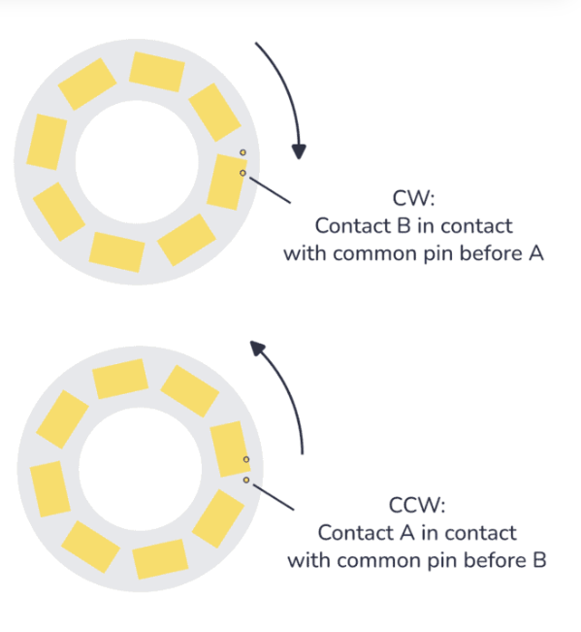
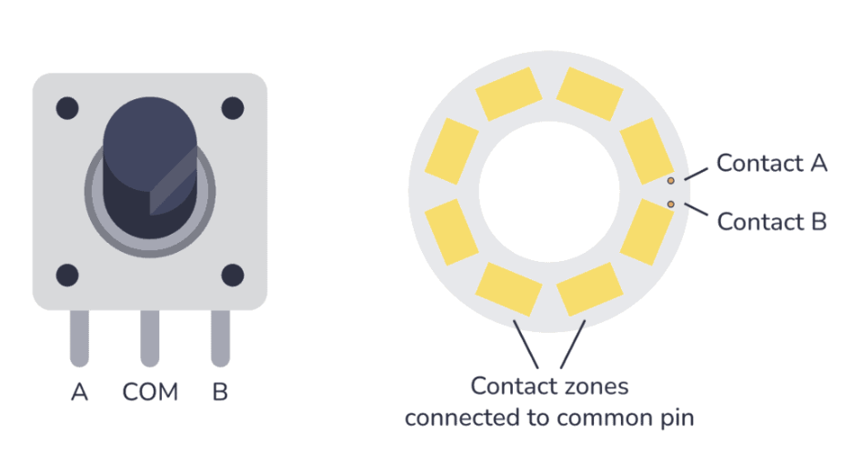

Rotary Encoder

Slide 20
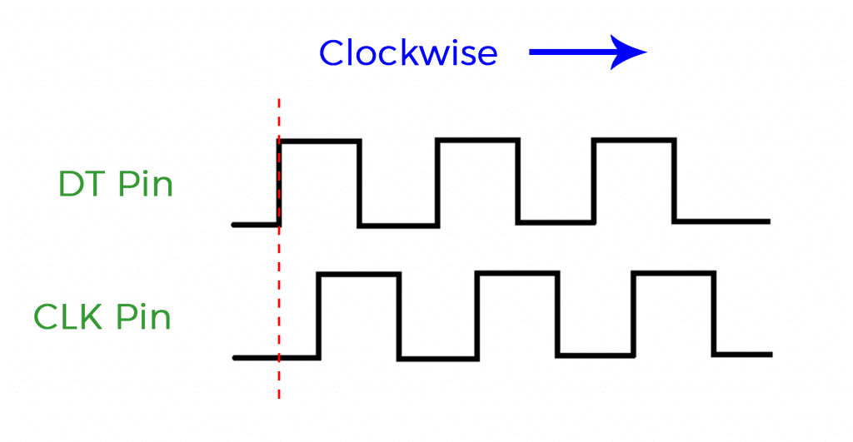
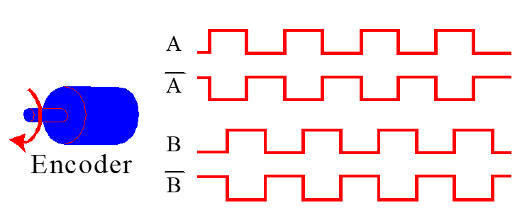
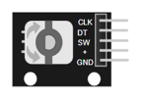
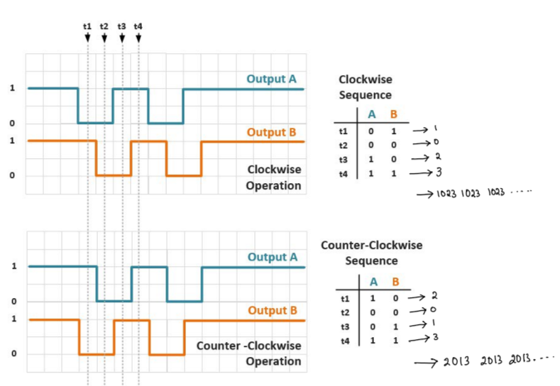
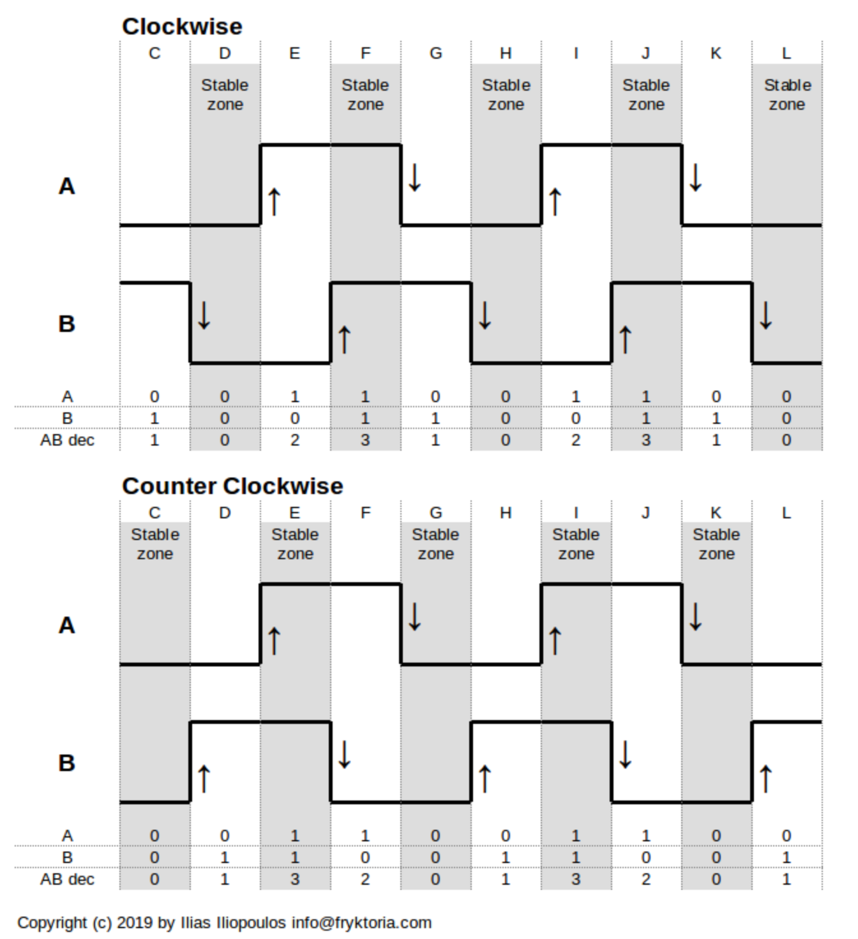
Working

Slide 21
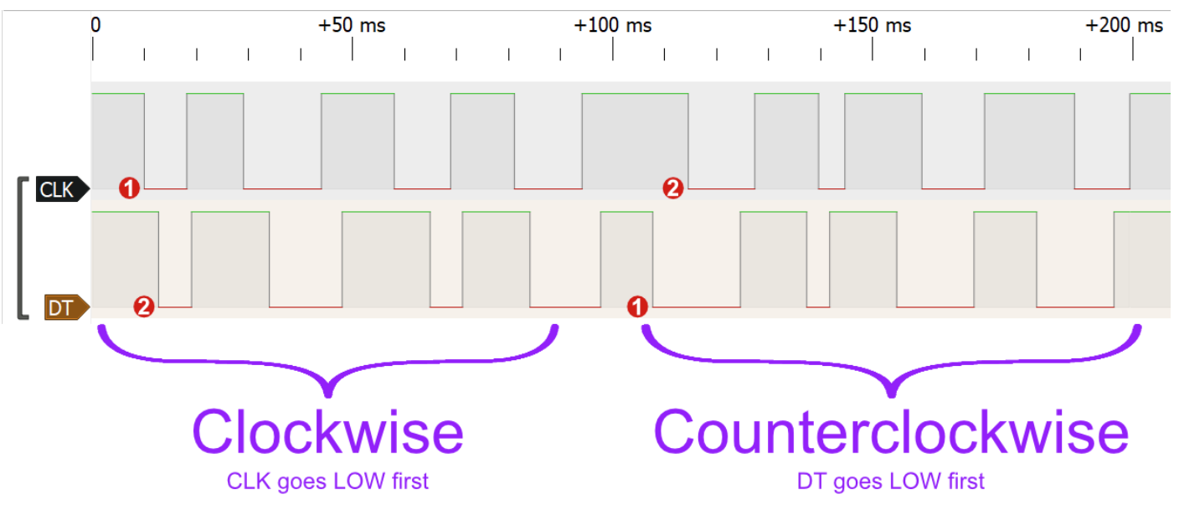
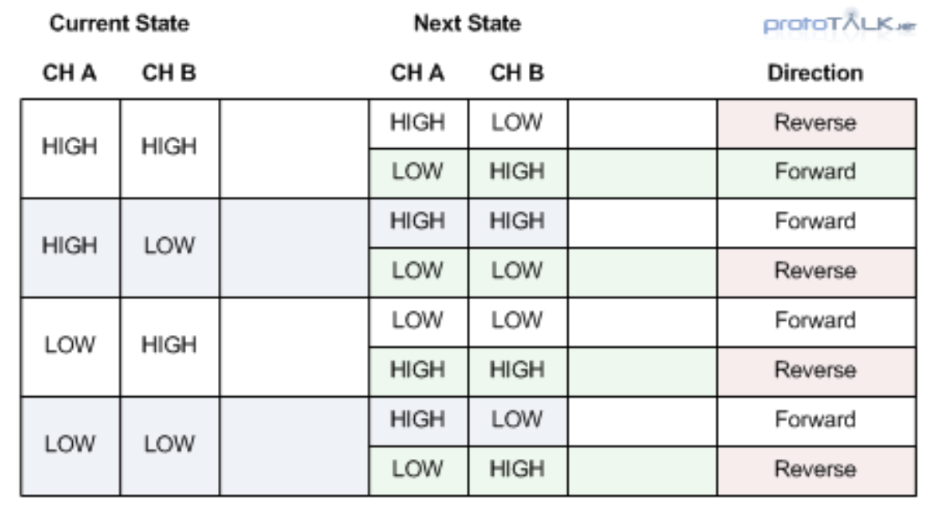
Truth table - Rotary Encode
Given the sequence for clockwise and counterclockwise rotation from the image:
Clockwise: DT changes after CLK, indicating CLK goes LOW first, followed by DT.
Counterclockwise: CLK changes after DT, indicating DT goes LOW first, followed by CLK.

Slide 22
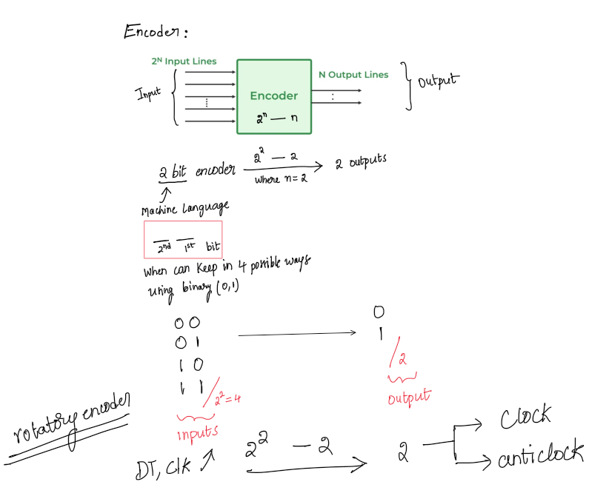
Rotary Encoder

Slide 23
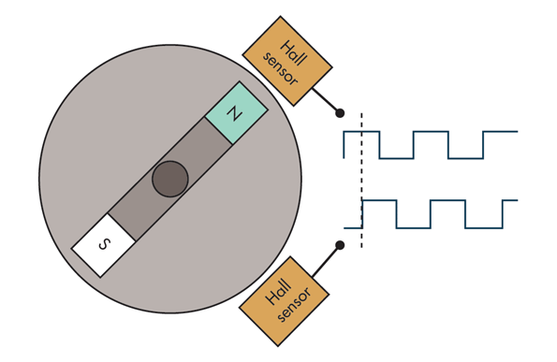
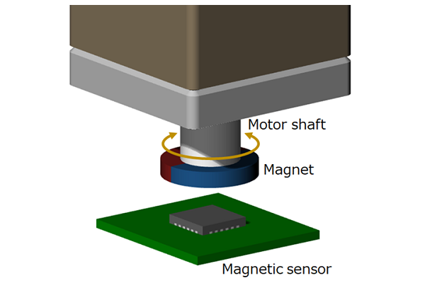
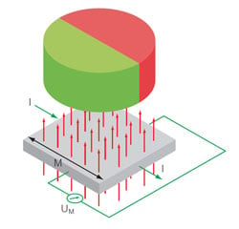
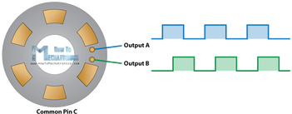
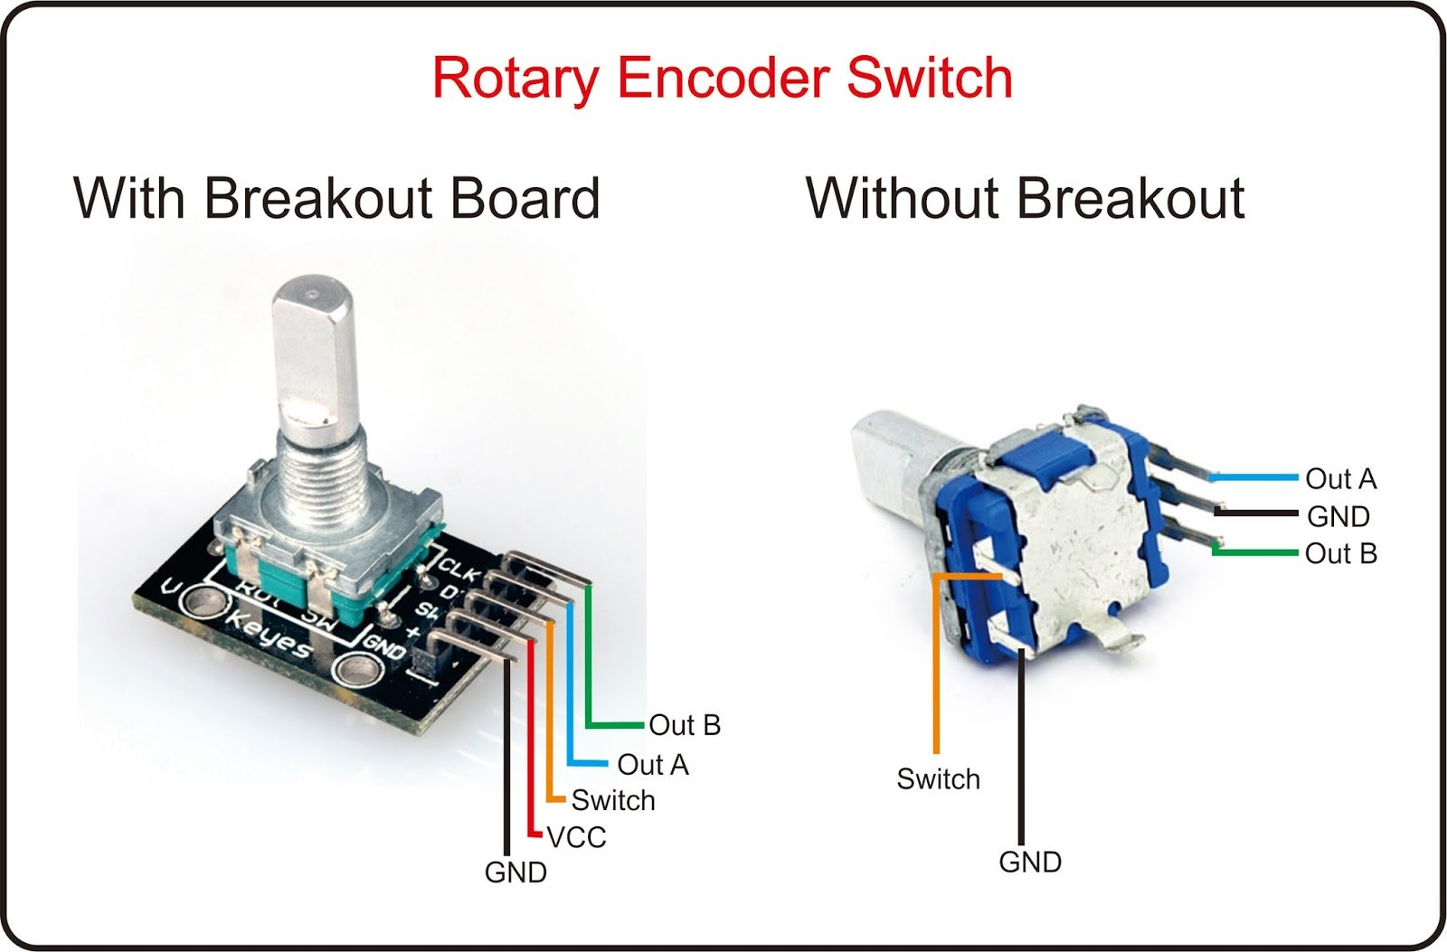
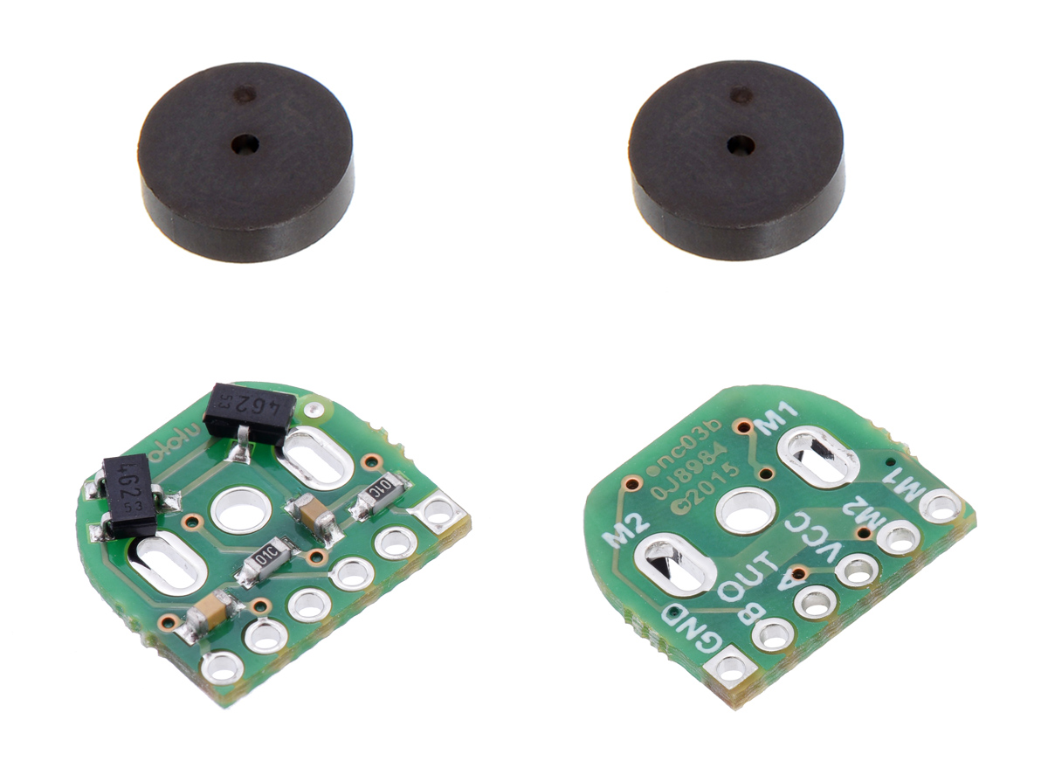
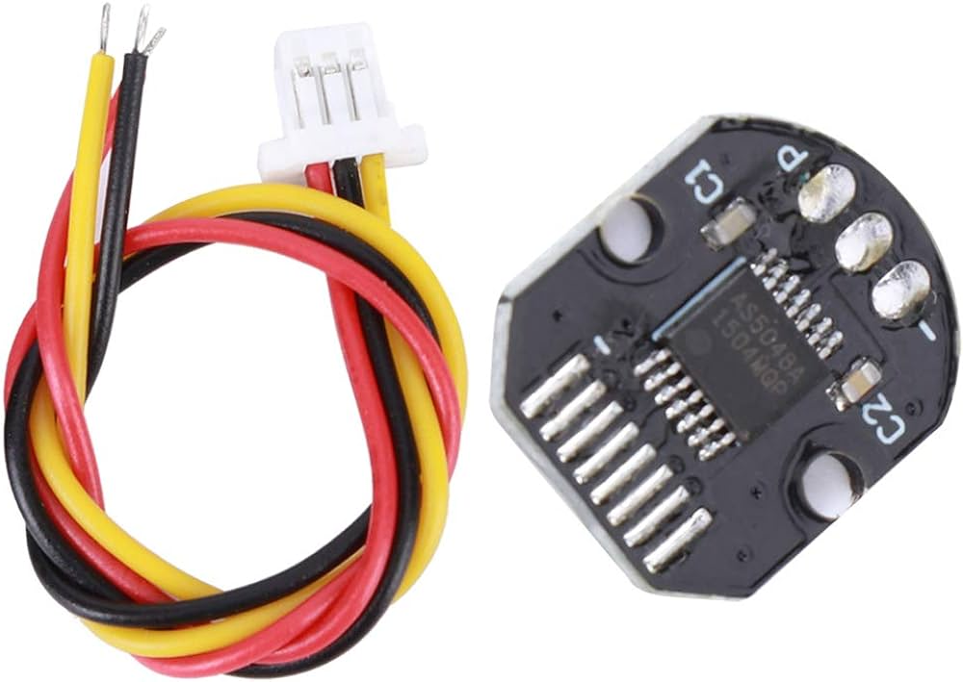
Types Rotary Encoder
Rotary Encoder
Quadrature Magnetic Encoder
Magnetic induction rotary encoder

Slide 24
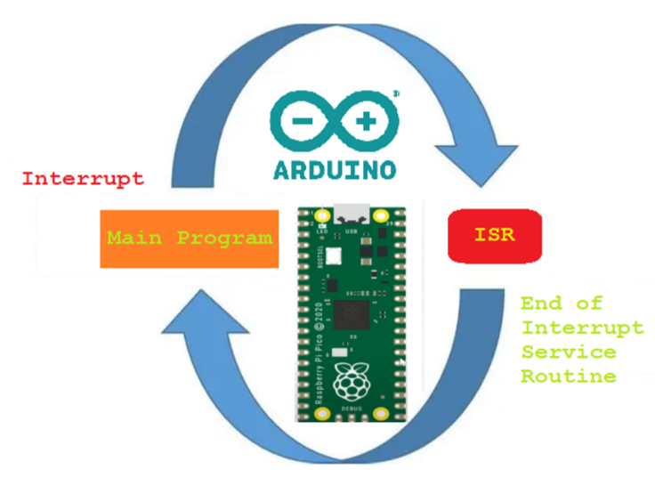
Interrupt

Slide 25
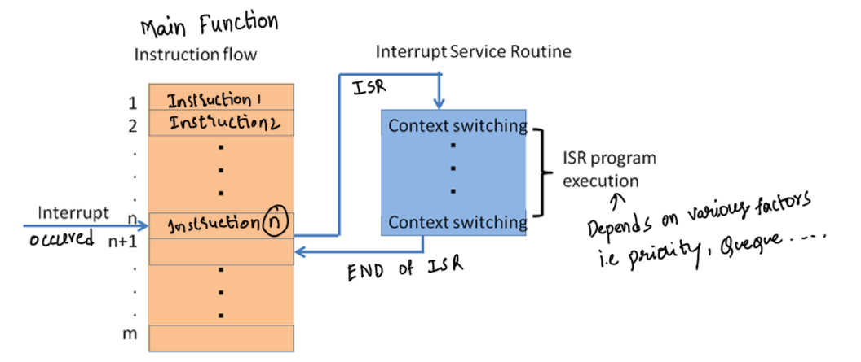
What is an interrupt? An interrupt in relation to microcontrollers is a mechanism that temporarily suspends the main program, passing control to an interim code.

Slide 26
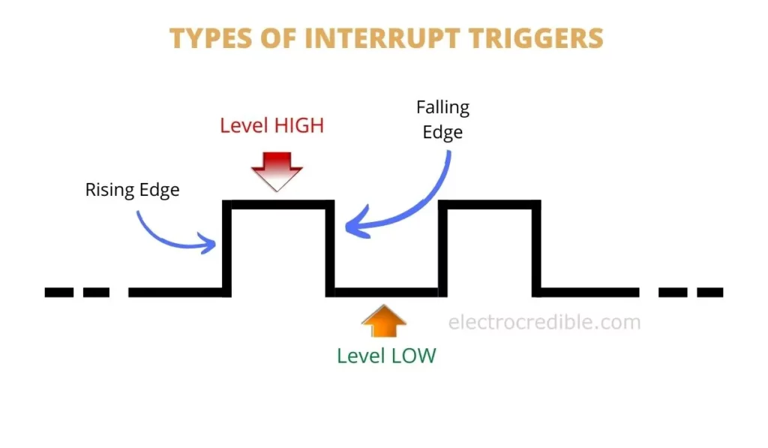
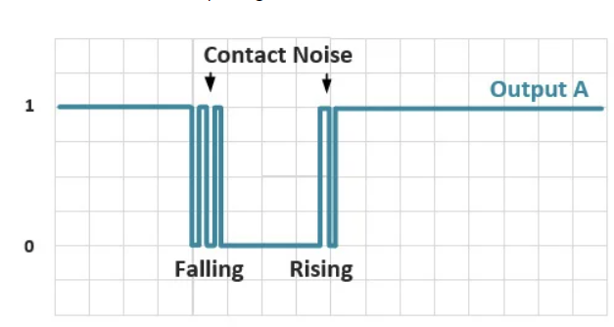
External Interrupts in Raspberry Pi Pico & Pico W
All GPIO pins in Raspberry Pi Pico support interrupts. The interrupts can be classified into three types:
Level High: An interrupt occurs when a pin is HIGH or at logic 1.
Level Low: An interrupt occurs when a pin is LOW or at logic 0.
Rising Edge: Interrupt occurs when a pin transitions from a LOW to HIGH.
Falling Edge: Interrupt occurs when a pin transitions from HIGH to LOW.
The level interrupts in RPi Pico do not latch, i.e. the interrupt becomes inactive as soon the GPIO changes its state from HIGH to LOW or vice versa.

Slide 27
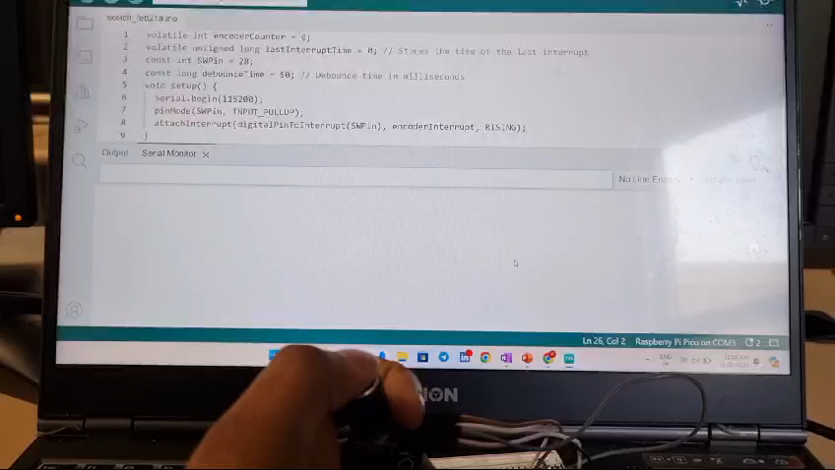
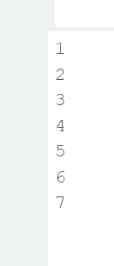
Programming 6:Interrupt - Encoder
const int SWPin = 28;
attachInterrupt(digitalPinToInterrupt(SWPin), encoderInterrupt, RISING);
Output
volatile int encoderCounter = 0;
volatile unsigned long lastInterruptTime = 0; // Stores the time of the last interrupt
const int SWPin = 28;
const long debounceTime = 50; // Debounce time in milliseconds
void setup() {
Serial.begin(115200);
pinMode(SWPin, INPUT_PULLUP);
attachInterrupt(digitalPinToInterrupt(SWPin), encoderInterrupt, RISING);
}
void loop() {
static int lastCounter = 0;
noInterrupts(); // Temporarily disables interrupts to ensure a consistent read of encoderCounter
int currentCounter = encoderCounter;
interrupts(); // Re-enable interrupts
if (currentCounter != lastCounter) {
Serial.println(currentCounter);
lastCounter = currentCounter;
}
}
void encoderInterrupt() {
unsigned long currentTime = millis(); // Get the current time in milliseconds
if (currentTime - lastInterruptTime > debounceTime) {
encoderCounter++;
lastInterruptTime = currentTime;
}
}
For online Simulations: https://wokwi.com/projects/389680162133229569

Slide 28
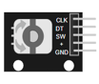
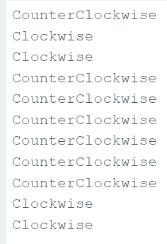
Programming 6.1: Direction - Encoder
const int pinA = 26; // CLK
const int pinB = 27; // DT
const int SWPin = 28;
attachInterrupt(digitalPinToInterrupt(pinA), readEncoder, CHANGE);
volatile int encoderCounter = 0;
volatile unsigned long lastInterruptTime = 0;
const int pinA = 26; // CLK
const int pinB = 27; // DT
const long debounceTime = 50; // Debounce time in milliseconds
void setup() {
Serial.begin(115200);
pinMode(pinA, INPUT_PULLUP);
pinMode(pinB, INPUT_PULLUP);
attachInterrupt(digitalPinToInterrupt(pinA), readEncoder, CHANGE);
}
void loop() {
static int lastCounter = 0;
noInterrupts();
int currentCounter = encoderCounter;
interrupts();
if (currentCounter != lastCounter) {
Serial.println(currentCounter > lastCounter ? "Clockwise" : "CounterClockwise");
lastCounter = currentCounter;
}
}
void readEncoder() {
unsigned long currentTime = millis();
if (currentTime - lastInterruptTime > debounceTime) {
// Determine direction based on the state of pinA and pinB
if (digitalRead(pinA) == digitalRead(pinB)) {
encoderCounter--;
} else {
encoderCounter++;
}
lastInterruptTime = currentTime;
}
}
Output
For online Simulations: https://wokwi.com/projects/390357026915917825

Slide 29
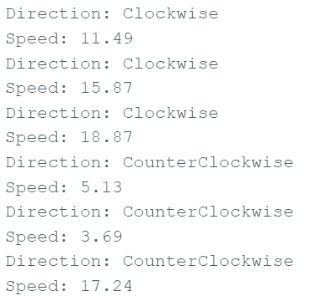
Programming 6.2: Speed - Encoder
Output
volatile int encoderCounter = 0;
volatile unsigned long lastInterruptTime = 0;
volatile unsigned long lastRotationTime = 0; // Time when the last rotation occurred
volatile float speed = 0; // Speed of rotation
const int pinA = 26; // CLK
const int pinB = 27; // DT
const long debounceTime = 50; // Debounce time in milliseconds
void setup() {
Serial.begin(115200);
pinMode(pinA, INPUT_PULLUP);
pinMode(pinB, INPUT_PULLUP);
attachInterrupt(digitalPinToInterrupt(pinA), readEncoder, CHANGE);
}
void loop() {
static int lastCounter = 0;
noInterrupts();
int currentCounter = encoderCounter;
float currentSpeed = speed; // Copy the speed calculated in the interrupt
interrupts();
if (currentCounter != lastCounter) {
Serial.print("Direction: ");
Serial.println(currentCounter > lastCounter ? "Clockwise" : "CounterClockwise");
Serial.print("Speed: ");
Serial.println(currentSpeed, 2); // Print speed with 2 decimal places
lastCounter = currentCounter;
}
}
void readEncoder() {
unsigned long currentTime = millis();
if (currentTime - lastInterruptTime > debounceTime) {
// Determine direction based on the state of pinA and pinB
if (digitalRead(pinA) == digitalRead(pinB)) {
encoderCounter--;
} else {
encoderCounter++;
}
// Calculate speed
if (lastRotationTime > 0) {
unsigned long timeDifference = currentTime - lastRotationTime;
// Prevent division by zero and calculate speed in steps per second
if (timeDifference > 0) {
speed = 1000.0 / timeDifference;
}
}
lastRotationTime = currentTime;
lastInterruptTime = currentTime;
}
}
For online Simulations: https://wokwi.com/projects/389680951256971265

Slide 30
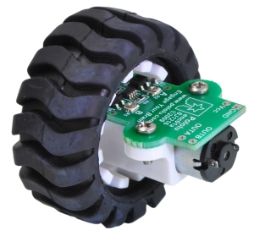
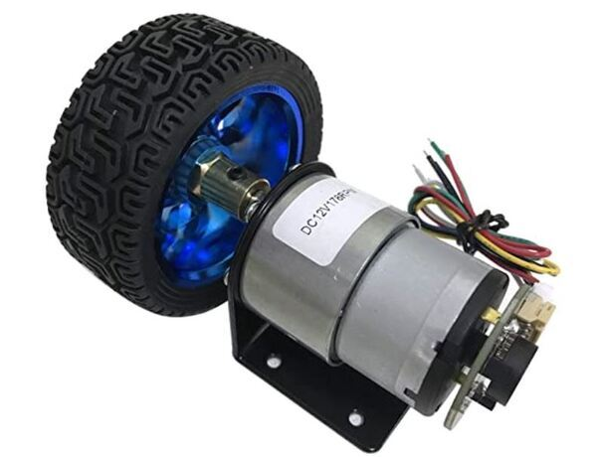

Programming 5: Rotary Encoder & Odometry
const int ledPin1 = 16;
const int ledPin2 = 17;
const int ledPin3 = 18;
const int ledPin4 = 19;
const int SWPin = 28;
const int DTPin = 27; // Rotary Encoder DT pin connected to pin 27
const int CLKPin = 26; // Rotary Encoder CLK pin connected to pin 26
void setup() {
Serial.begin(9600);
pinMode(SWPin, INPUT_PULLUP); // Using INPUT_PULLUP to enable internal pull-up resistor
pinMode(DTPin, INPUT);
pinMode(CLKPin, INPUT); // Corrected to CLKPin
pinMode(ledPin1, OUTPUT);
pinMode(ledPin2, OUTPUT);
pinMode(ledPin3, OUTPUT);
pinMode(ledPin4, OUTPUT);
}
int lastCLKState = digitalRead(CLKPin); // Initialize lastCLKState with the current state of CLKPin
void loop() {
int currentCLK = digitalRead(CLKPin);
if (currentCLK != lastCLKState) { // If the CLK state has changed
if (digitalRead(DTPin) != currentCLK) {
Serial.println("Rotated clockwise");
} else {
Serial.println("Rotated counterclockwise");
}
lastCLKState = currentCLK; // Update lastCLKState with the new state
}
}
For online Simulations: https://wokwi.com/projects/390360272695139329

Slide 31
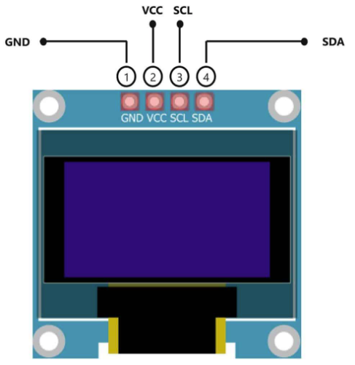
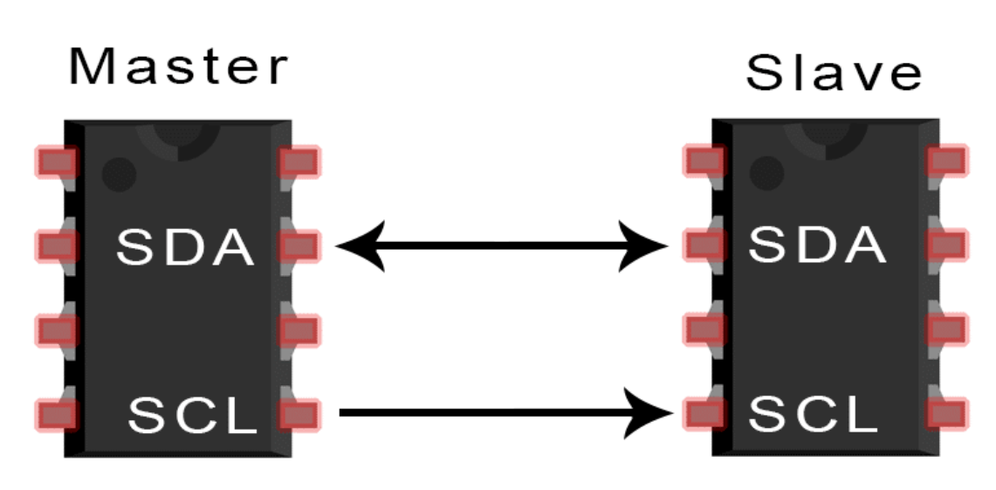
PICO – OLED

Slide 32
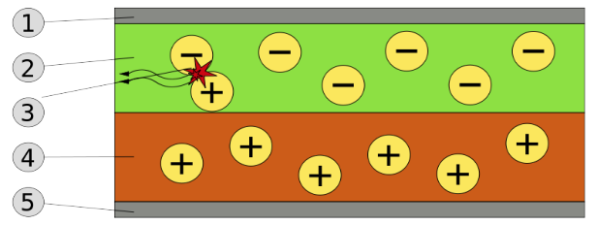
What is OLED's
An OLED is a solid-state device consisting of a thin, carbon-based semiconductor layer that emits light when electricity is applied by adjacent electrodes. In order for light to escape from the device, at least one of the electrodes must be transparent
Cathode 2000A
Emissive Layer 800A
Photon Radiation
Conductive Layer 1200A
Anode 1500A

Slide 33




PICO – OLED libraries

Slide 34

#include <Arduino.h>
#include <U8g2lib.h>
#include <Wire.h>
U8G2_SSD1306_128X64_NONAME_F_HW_I2C u8g2(U8G2_R0, /* reset=*/ U8X8_PIN_NONE);
void setup(void) {
u8g2.begin();
}
void loop(void) {
u8g2.clearBuffer();
u8g2.setFont(u8g2_font_ncenB08_tr);
u8g2.drawStr(0, 20, "ATR lab");
u8g2.sendBuffer();
}

Slide 35
UDP – Server/Client

Slide 36


UDP – Server(pico) and client(pc)
Upload the code into pico
Run the python code using terminal
#include <WiFi.h>
#include <WiFiUdp.h>
// Replace these with your WiFi network settings
const char* ssid = "SHIELD";
const char* password = "AVENGERS";
WiFiUDP udp;
const unsigned int localPort = 8888; // Local port to listen on
void setup() {
Serial.begin(115200);
// Connect to WiFi
WiFi.begin(ssid, password);
while (WiFi.status() != WL_CONNECTED) {
delay(500);
Serial.print(".");
}
Serial.println("WiFi connected");
Serial.print("IP address: ");
Serial.println(WiFi.localIP());
// Start UDP
udp.begin(localPort);
Serial.print("UDP server started on port ");
Serial.println(localPort);
}
void loop() {
int packetSize = udp.parsePacket();
if (packetSize) {
// Received a packet
Serial.print("Received packet of size ");
Serial.println(packetSize);
Serial.print("From ");
IPAddress remoteIp = udp.remoteIP();
for (int i = 0; i < 4; i++) {
Serial.print(remoteIp[i], DEC);
if (i < 3) {
Serial.print(".");
}
}
Serial.print(", port ");
Serial.println(udp.remotePort());
// Read the packet into a string
String incomingPacket = "";
while (udp.available()) {
incomingPacket += (char)udp.read();
}
Serial.print("Contents: ");
Serial.println(incomingPacket);
}
}
import socket
# Server IP and Port
server_ip = "192.168.252.124" # Replace PICO_IP_ADDRESS with the actual IP address of your Pico
server_port = 8888
# Create a UDP socket
client_socket = socket.socket(socket.AF_INET, socket.SOCK_DGRAM)
# Timeout for receiving the response (optional)
client_socket.settimeout(1)
try:
while True:
# Get user input from the keyboard ('1', '2', '3', '4')
message = input("Enter your message ('1', '2', '3', '4'): ")
if message in ['1', '2', '3', '4']:
# Send the message to the server
client_socket.sendto(message.encode(), (server_ip, server_port))
print(f"Sent '{message}' to the server.")
else:
print("Please enter only '1', '2', '3', or '4'.")
except KeyboardInterrupt:
print("Program exited.")
finally:
client_socket.close()

Slide 37

UDP – Server(pico) and client(pc) <keeping led and oled> <led on as output>
Upload the code into pico
Run the python code using terminal
#include <WiFi.h>
#include <WiFiUdp.h>
#include <U8g2lib.h>
#include <Wire.h>
// WiFi network settings
const char* ssid = "SHIELD";
const char* password = "AVENGERS";
WiFiUDP udp;
const unsigned int localPort = 8888; // Local port to listen for UDP messages
// OLED display setup
U8G2_SSD1306_128X64_NONAME_F_HW_I2C u8g2(U8G2_R0, U8X8_PIN_NONE);
// GPIO pins for the LEDs
const int ledPins[4] = {16, 17, 18, 19};
void setup() {
Serial.begin(115200);
// Connect to WiFi
WiFi.begin(ssid, password);
while (WiFi.status() != WL_CONNECTED) {
delay(500);
Serial.print(".");
}
Serial.println("\nWiFi connected");
Serial.print("IP address: ");
Serial.println(WiFi.localIP());
// Start the UDP server
udp.begin(localPort);
Serial.print("UDP server started on port ");
Serial.println(localPort);
// Initialize the OLED display
u8g2.begin();
// Test display message
u8g2.clearBuffer();
u8g2.setFont(u8g2_font_ncenB08_tr);
u8g2.drawStr(0, 20, "Startup OK");
u8g2.sendBuffer();
delay(2000); // Show the message for 2 seconds
// Initialize LED pins
for (int i = 0; i < 4; i++) {
pinMode(ledPins[i], OUTPUT);
digitalWrite(ledPins[i], LOW); // Ensure all LEDs are off initially
}
}
void loop() {
int packetSize = udp.parsePacket();
if (packetSize) {
// Read the incoming packet
String incomingPacket = "";
int len = udp.read((unsigned char*)incomingPacket.begin(), 255);
if (len > 0) incomingPacket[len] = 0;
Serial.print("Received packet of size ");
Serial.println(packetSize);
Serial.print("Contents: ");
Serial.println(incomingPacket);
// Process the incoming message
if (incomingPacket >= "1" && incomingPacket <= "4") {
int ledNumber = incomingPacket.toInt() - 1;
// Turn off all LEDs
for (int i = 0; i < 4; i++) {
digitalWrite(ledPins[i], LOW);
}
// Turn on the selected LED
digitalWrite(ledPins[ledNumber], HIGH);
// Update the OLED display
u8g2.clearBuffer();
u8g2.setFont(u8g2_font_ncenB08_tr);
String message = "LED " + incomingPacket + " ON";
u8g2.drawStr(0, 20, message.c_str());
u8g2.sendBuffer();
// Print to Serial Monitor
Serial.println(message);
}
}
}

Slide 38
UDP – Server(pico) and client(pc) <leds with their number>
Upload the code into pico
Run the python code using terminal
#include <WiFi.h>
#include <WiFiUdp.h>
#include <U8g2lib.h>
#include <Wire.h>
// WiFi network settings
const char* ssid = "SHIELD";
const char* password = "AVENGERS";
WiFiUDP udp;
const unsigned int localPort = 8888; // Local port to listen for UDP messages
// OLED display setup
U8G2_SSD1306_128X64_NONAME_F_HW_I2C u8g2(U8G2_R0, U8X8_PIN_NONE);
// GPIO pins for the LEDs
const int ledPins[4] = {16, 17, 18, 19};
void setup() {
Serial.begin(115200);
// Connect to WiFi
WiFi.begin(ssid, password);
while (WiFi.status() != WL_CONNECTED) {
delay(500);
Serial.print(".");
}
Serial.println("\nWiFi connected");
Serial.print("IP address: ");
Serial.println(WiFi.localIP());
// Start the UDP server
udp.begin(localPort);
Serial.print("UDP server started on port ");
Serial.println(localPort);
// Initialize the OLED display
u8g2.begin();
// Test display message
u8g2.clearBuffer();
u8g2.setFont(u8g2_font_ncenB08_tr);
u8g2.drawStr(0, 20, "Startup OK");
u8g2.sendBuffer();
delay(2000); // Show the message for 2 seconds
// Initialize LED pins
for (int i = 0; i < 4; i++) {
pinMode(ledPins[i], OUTPUT);
digitalWrite(ledPins[i], LOW); // Ensure all LEDs are off initially
}
}
void loop() {
int packetSize = udp.parsePacket();
if (packetSize) {
// Read the incoming packet
char incomingPacket[255]; // Make sure the buffer is large enough
int len = udp.read((unsigned char*)incomingPacket, 255);
if (len > 0) incomingPacket[len] = 0; // Null-terminate the string
Serial.print("Received packet of size ");
Serial.println(packetSize);
Serial.print("Contents: ");
Serial.println(incomingPacket);
// Process the incoming message
if (incomingPacket[0] >= '1' && incomingPacket[0] <= '4') {
int ledNumber = incomingPacket[0] - '0' - 1;
// Turn off all LEDs
for (int i = 0; i < 4; i++) {
digitalWrite(ledPins[i], LOW);
}
// Turn on the selected LED
digitalWrite(ledPins[ledNumber], HIGH);
// Update the OLED display
u8g2.clearBuffer();
u8g2.setFont(u8g2_font_ncenB08_tr);
char message[20];
sprintf(message, "LED %d ON", ledNumber + 1); // Format the message with LED number
u8g2.drawStr(0, 20, message);
u8g2.sendBuffer();
// Print to Serial Monitor
Serial.println(message);
}
}
}

Slide 39
UDP – Server(pico) and client(pc)
void loop() {
int packetSize = udp.parsePacket();
if (packetSize) {
char incomingPacket[255]; // Buffer for incoming packet
int len = udp.read((unsigned char*)incomingPacket, 255);
if (len > 0) incomingPacket[len] = 0; // Null-terminate the string
Serial.print("Received packet of size ");
Serial.println(packetSize);
Serial.print("Contents: ");
Serial.println(incomingPacket);
// Initial motor stop state
stopMotors();
// Process the incoming message for motor control
switch (incomingPacket[0]) {
case '1': // Forward
driveForward();
break;
case '2': // Backward
driveBackward();
break;
case '3': // Left
turnLeft();
break;
case '4': // Right
turnRight();
break;
}
// Update OLED display
updateOLED(incomingPacket[0]);
// Print action to Serial Monitor
Serial.printf("Action: %c\n", incomingPacket[0]);
}
}
void driveForward() {
digitalWrite(rightMotorINT1, HIGH);
digitalWrite(rightMotorINT2, LOW);
digitalWrite(leftMotorINT1, HIGH);
digitalWrite(leftMotorINT2, LOW);
}
void driveBackward() {
digitalWrite(rightMotorINT1, LOW);
digitalWrite(rightMotorINT2, HIGH);
digitalWrite(leftMotorINT1, LOW);
digitalWrite(leftMotorINT2, HIGH);
}
void turnLeft() {
digitalWrite(rightMotorINT1, HIGH);
digitalWrite(rightMotorINT2, LOW);
digitalWrite(leftMotorINT1, LOW);
digitalWrite(leftMotorINT2, HIGH); // Adjust as needed for your motor configuration
}
void turnRight() {
digitalWrite(rightMotorINT1, LOW);
digitalWrite(rightMotorINT2, HIGH);
digitalWrite(leftMotorINT1, HIGH);
digitalWrite(leftMotorINT2, LOW); // Adjust as needed for your motor configuration
}
void stopMotors() {
digitalWrite(rightMotorINT1, LOW);
digitalWrite(rightMotorINT2, LOW);
digitalWrite(leftMotorINT1, LOW);
digitalWrite(leftMotorINT2, LOW);
}
void updateOLED(char command) {
char message[20];
switch (command) {
case '1':
sprintf(message, "Moving Forward");
break;
case '2':
sprintf(message, "Moving Backward");
break;
case '3':
sprintf(message, "Turning Left");
break;
case '4':
sprintf(message, "Turning Right");
break;
default:
sprintf(message, "Stopped");
break;
}
u8g2.clearBuffer();
u8g2.setFont(u8g2_font_ncenB08_tr);
u8g2.drawStr(0, 20, message);
u8g2.sendBuffer();
}
Upload the code into pico
#include <WiFi.h>
#include <Arduino.h>
#include <WiFiUdp.h>
#include <U8g2lib.h>
#include <Wire.h> // Motor pins
const int rightMotorE1 = 8;
const int rightMotorE2 = 9;
const int leftMotorE1 = 14;
const int leftMotorE2 = 15;
const int rightMotorINT1 = 10;
const int rightMotorINT2 = 11;
const int leftMotorINT1 = 12;
const int leftMotorINT2 = 13; // WiFi network settings
const char* ssid = "SHIELD";
const char* password = "AVENGERS"; WiFiUDP udp;
const unsigned int localPort = 8888; // Local port to listen for UDP messages // OLED display setup
U8G2_SSD1306_128X64_NONAME_F_HW_I2C u8g2(U8G2_R0, U8X8_PIN_NONE); // GPIO pins for the LEDs
const int ledPins[4] = {16, 17, 18, 19}; void setup() {
Serial.begin(115200); // Set motor pins as outputs
pinMode(rightMotorE1, OUTPUT);
pinMode(rightMotorE2, OUTPUT);
pinMode(leftMotorE1, OUTPUT);
pinMode(leftMotorE2, OUTPUT);
pinMode(rightMotorINT1, OUTPUT);
pinMode(rightMotorINT2, OUTPUT);
pinMode(leftMotorINT1, OUTPUT);
pinMode(leftMotorINT2, OUTPUT); // Connect to WiFi
WiFi.begin(ssid, password);
while (WiFi.status() != WL_CONNECTED) {
delay(500);
Serial.print(".");
}
Serial.println("\nWiFi connected");
Serial.print("IP address: ");
Serial.println(WiFi.localIP()); // Start the UDP server
udp.begin(localPort);
Serial.print("UDP server started on port ");
Serial.println(localPort); // Initialize the OLED display
u8g2.begin(); // Test display message
u8g2.clearBuffer();
u8g2.setFont(u8g2_font_ncenB08_tr);
u8g2.drawStr(0, 20, "Startup OK");
u8g2.sendBuffer();
delay(2000); // Show the message for 2 seconds
// Initialize LED pins
for (int i = 0; i < 4; i++) {
pinMode(ledPins[i], OUTPUT);
digitalWrite(ledPins[i], LOW); // Ensure all LEDs are off initially
}
}

Slide 40
THANK YOU

